Slide 1
etawa Sundowner 2024
Steven Kemp

Slide 2
School Visits
Good news!
Curtin University are continuing to sponsor my school visits in 2024
If you would like me to visit your class then call, text or email
Email: stevenkemp@me.com
Mobile: 0407986901

Slide 3
Exam Papers
Unit 3 – from etawa
If you want a Unit 4 exam paper/marking guide call or text me (0407986901)

Slide 4
Unit 1/2 Teaching Slides
Updated for the 8th edition
$90 per set
Unit 1 – Microeconomics
5 chapters
Unit 2 – Macroeconomics
6 chapters

Slide 5
2023 Exam Paper Section Means
2023 2022 2021
Section 1 71% 73% 68%
Section 2 59% 54% 54%
Section 3 53% 45% 54%
Total 59% 55% 57%
Range: 0 - 96
The reliability of the exam (0.87) was similar to 2022

Slide 6
Section One: Multiple Choice
Range: 0-24; Mean 71% (last year 73%)
Difficult questions ( < 50%): 3
Easy questions: (> 80%) 9
Reliability: 0.67 (last year 0.71)

Slide 7
Section 1
Low correlation
Mean = 58%
3. An economic effect of globalisation in Australia has been
(a) an appreciation of the Australian dollar.
(b) increased inflation.
(c) increased cyclical unemployment.
(d) the lowering of trade barriers.

Slide 8
Section 1
Low mean 36%
Low correlation
9. Australia's top five two-way trading partners in 2022 were
(a) China, USA, United Kingdom, South Korea, Japan.
(b) China, Japan, South Korea, USA, Singapore.
(c) Japan, China, United Kingdom, USA, South Korea.
(d) China, Japan, South Korea, India, USA.
34%
Note - 2 answers are the same!!

Slide 9
Section 1
Very low correlation
13. Low inflation, rising unemployment and high savings rates are characteristics of which phase of the business cycle?
(a) contraction
(b) trough
(c) expansion
(d) boom

Slide 10
Section 1
Very low correlation
Mean = 85%
23. Which of the following is most likely to contribute to growth in Australia's renewable energy market?
(a) a fall in incomes of Australia's closest trading partners
(b) increased trade protection for the renewable energy industry
(c) government funding to increase innovation and productivity in the energy sector
(d) allowing cheaper renewable energy products from overseas
Is there an obvious long answer!

Slide 11
Section 1
Very low correlation
Mean = 62%
24. A reason for the decline in productivity growth levels in Australia over the last 10 years is
(a) faster than expected rates of technical progress and innovation.
(b) rising rates of economic growth.
(c) increased capital deepening.
(d) increased globalisation, causing structural change.
2 answers have a positive correlation

Slide 12
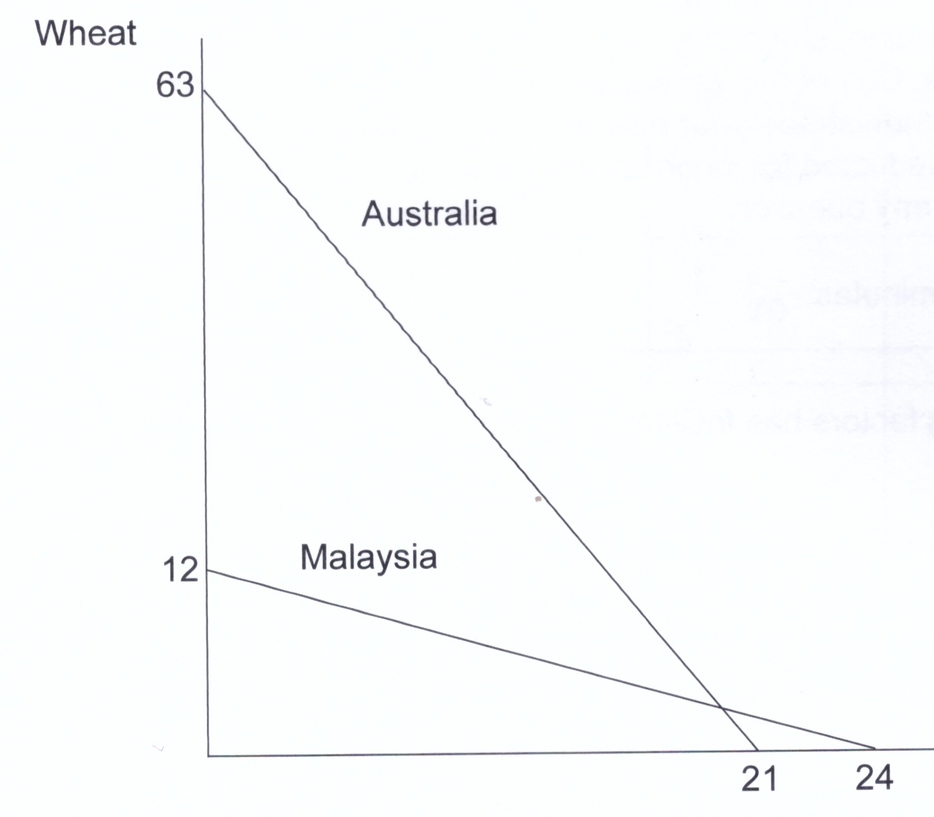
Section 1
Very high correlation
Mean = 73%
5. According to the model,
(a) Australia has an absolute advantage in wheat and a comparative advantage in rubber.
(b) Malaysia has an absolute and comparative advantage in the production of rubber.
(c) Australia has an absolute advantage in the production of wheat and rubber.
(d) Malaysia has an absolute advantage in rubber and a comparative advantage in wheat.
Rubber

Slide 13
Section 1
Very low mean
Mean = 31%
6. The terms of trade that would allow both countries to engage in trade is
(a) Australia receives one unit of rubber for one unit of wheat.
(b) Malaysia receives 0.5 units of wheat for one unit of rubber.
(c) Australia receives two units of rubber for one unit of wheat.
(d) Malaysia receives 0.5 units of wheat for two units of rubber.
Rubber

Slide 14
Section 1
Very low mean
Mean = 31%
How do I work out the terms of trade?
First, calculate the opportunity cost for one of the goods in each country
e.g. 1 rubber = ____ wheat in Australia
1 rubber = ____ wheat in Malaysia
So the terms of trade for rubber must lie between these values i.e. > 0.5 and < 3
3
0.5
Rubber

Slide 15
Section 1
Very low mean
Mean = 31%
6. The terms of trade that would allow both countries to engage in trade is
(a) Australia receives one unit of rubber for one unit of wheat.
(b) Malaysia receives 0.5 units of wheat for one unit of rubber.
(c) Australia receives two units of rubber for one unit of wheat.
(d) Malaysia receives 0.5 units of wheat for two units of rubber.
Rubber

Slide 16
Section 1
Very Low mean 25%
15. According to the aggregate expenditure (AE) model, when the level of income is below equilibrium, then the inventory levels of firms are
(a) rising, which causes production to decrease.
(b) falling, which causes production to decrease.
(c) rising, which causes production to increase.
{d) falling, which causes production to increase.

Slide 17
AE Model
AE
AE
At Y1, income is less than expenditure
Inventories will ___________
Firms will increase production
Real GDP will increase
decrease
45º
Y1
Ye
Real GDP (Y)

Slide 18
Section 1
Very Low mean 25%
15. According to the aggregate expenditure (AE) model, when the level of income is below equilibrium, then the inventory levels of firms are
(a) rising, which causes production to decrease.
(b) falling, which causes production to decrease.
(c) rising, which causes production to increase.
{d) falling, which causes production to increase.
52%

Slide 19
Section 2
The mean was 59%
Range: 0 - 36
Strong correlation with exam total (0.87)
Q25 – Terms of trade (mean = 49%)
Q26 – Productivity (mean = 61%)
Q27 – Fiscal policy (Budget) (mean = 66%)
Too low
Note – models were required in 2 of the 3 questions!

Slide 20
Section 2
Question 25
(b) Outline two reasons for the trend in the terms of trade. (4 marks)
Mean = 40%
The terms of trade increased from 89.6 – to 138.6.
Both the XPI & the MPI increased.
Answers must relate to the increase in the XPI
Higher iron ore prices due to increased demand from China
Higher energy & food prices due to supply shocks

Slide 21
Section 2
Price
Iron Ore market
S
What can cause an increase in commodity prices e.g. iron ore?
An increase in demand – e.g. China increases iron ore purchases
The XPI index increases
P2
P1
D1
D
Q1
Q2
Qty

Slide 22
Section 2
Price
Cereal or Beef market
S1
S
What can cause an increase in food prices?
A decrease in supply – e.g. drought/supply bottleneck
The XPI index increases
P2
P2
D
Q2
Q1
Qty

Slide 23
Section 2
Question 25
(c) Explain two impacts on Australia’s economic activity of the change in the terms of trade index since 2018. (6 marks)
Mean = 46%
3 marks for explanation of each impact
Must relate to effect on economic activity – output, income, employment
Most students achieved a mark of only 3 – lacked depth of explanation

Slide 24
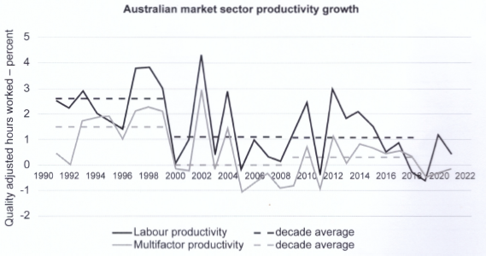
Section 2
What does this mean??
Question 26
(a) ii State the trend in labour productivity growth between 2018 and 2021.
Increasing

Slide 25
Section 2
Question 26
(c) Using an AD/AS model, explain the impact of lower levels of business investment on the level of economic activity in Australia. (6 marks)
Mean = 56%
4 marks for explanation – including multiplier effect
2 marks for model showing a decrease in AD
But . . .
“Some of the reasons why Australia's productivity is declining include lower levels of business investment” (p.11)

Slide 26
Section 1
18. According to the AD/AS model, a fall in a nation's productivity level will shift the
(a) aggregate supply (AS) curve to the right.
(b) aggregate supply (AS) curve to the left.
(c) aggregate demand (AD) curve to the right.
(d) aggregate demand (AD) curve to the left.
So what did many students do with the model?
They showed a decrease in AS!

Slide 27
Section 2
Question 27
(c) Using an AD/AS model, describe how the government uses discretionary fiscal policy spending on infrastructure projects to achieve long run price stability and economic growth in the Australian economy. (6 marks)
Mean = 56%
4 marks for explanation – including definition/example of infrastructure
2 marks for model showing an increase in AS
But . . .
Spending on infrastructure is investment which also increases AD

Slide 28
Section 3
The mean for this section was 53%. Range: 0 – 39.5
Low correlation with exam total 0.70
Q28 – Trade liberalisation (model) (mean 54%; chosen by 63%)
Q29 – Current account & exchange rate (model) (mean 51%; chosen by 36%)
Q30 – Monetary policy (model) (mean 53%; chosen by 82%)
Q31 – Structural change (model) (mean 48%; chosen by 15%)
*All questions referred to a MODEL!

Slide 29
Section 3
3 x 2 marks
2 marks
Unit 3 Question 28
(a) Outline the concept of free trade agreements and describe three arguments for trade liberalisation. (8 marks)
Mean = 60%
Very descriptive - generally well answered – most students achieving a mark of 5/8

Slide 30
Section 3
Unit 3 Question 28
(b) Using demand and supply models, demonstrate and explain how consumers and producers benefit from specialisation and trade. (12 marks) Mean = 50%
CONSUMERS (6 marks)
6 marks – explain how consumers benefit (increase in CS)
2 marks – model showing imports (Pw < Pd)
PRODUCERS (6 marks)
6 marks – explain how producers benefit (increase in PS)
2 marks – model showing exports (Pw > Pd)
PPF models are inappropriate!

Slide 31
Section 3
2 marks
Unit 3 Question 29
(a) Outline the concept of the current account balance and describe four cyclical reasons for the current account surpluses since 2019. (10 marks). Mean = 58%
4 x 2 marks
Not many students could correctly identify four cyclical factors – factors related to the trade balance

Slide 32
Section 3
2 marks
4 marks
Unit 3 Question 29
(b) Using a demand and supply model, demonstrate and explain the impact of falling commodity prices on the value of the Australian dollar (AUD) and explain the impact of this change on Australian consumers. (1O marks) Mean = 44%
4 marks
A fall in commodity prices will depreciate the $A. Why?
A fall in commodity prices ___________ the value of Aust’s commodity exports.
Many students did the opposite – stated that a fall in prices would appreciate the $A – awarded a mark of ZERO!
decreases

Slide 33
Section 3
Unit 3 Question 29
(b) Using a demand and supply model, demonstrate and explain the impact of falling commodity prices on the value of the Australian dollar (AUD) and explain the impact of this change on Australian consumers. (1O marks) Mean = 58%
Why do students get this wrong?
They think a fall in price increases demand – but this is WRONG!
In any market, price can only fall if either DEMAND ____________ or SUPPLY ____________.
decreases
increases

Slide 34
Commodity prices
Price
Iron Ore market
S
What can cause commodity prices to fall?
A decrease in demand or an increase in supply
P1
P2
D
D1
Q2
Q1
Qty

Slide 35
Section 3
2 marks
Unit 3 Question 30
(a) Outline the concept of monetary policy and describe three circumstances under which the Reserve Bank of Australia (RBA) may change the cash rate to achieve its macroeconomic objectives. (8 marks) Mean = 65%
3 x 2 marks
Generally well answered
3 circumstances – either relate to achieving the three key obiectives – price stability, full employment & economic growth
3 circumstances – or relate to different stances – expansionary, contractionary or neutral

Slide 36
Section 3
2 marks
Unit 3 Question 30
(b) Using an aggregate expenditure (AE) model, analyse the impact of rising interest rates on output and expenditure in the Australian economy. (12 marks) Mean = 45%
10marks
Note 10 marks allocated to analysing the impact on both output and expenditure
Most students only achieved a mark of 3/10!
Must refer to
both output & expenditure
the multiplier
the channels of the transmission mechanism

Slide 37
New Exam Structure
Section 1 Multiple choice – 20 questions (20 marks)
Section 2 Data Interpretation – 4 questions (50 marks)
Unit 3 – answer 2 questions (25 marks)
Unit 4 – answer 2 questions (25 marks)
Section 3 Extended Answer – 2 questions (30 marks)
Unit 3 – answer 1 from choice of 2 questions (15 marks)
Unit 4 – answer 1 from choice of 2 questions (15 marks)
Effect on student performance?
Expected mean: 60-65%

Slide 38
New Section 3 Questions
Each question is of equal value and in the form of an extended answer.
Questions can require the candidate to account for, assess, demonstrate, describe, discuss, evaluate and/or explain.
Note: no outline or analyse
Questions can require the candidate to apply economic concepts, theories and/or models.
The question may include stimulus material.

Slide 39
New Section 3 Questions
Unit 3 Sample Question (15 marks)
Explain the reasons why governments use protectionist policies and the impact that these policies have on the economy.
In your response include:
a definition of protection
two arguments for trade protection
the impact of a subsidy on market efficiency and the macroeconomy
an appropriate economic model to demonstrate the impact of a subsidy on market efficiency and the macroeconomy.
Scaffolded questions will increase the mean

Slide 40
New Section 3 Questions
Unit 4 Sample Question (15 marks)
Using the Aggregate Expenditure model, explain the concept of macroeconomic equilibrium and how a change in investment spending can change the equilibrium level of income and output in the economy.
15 mark questions will decrease the mean

Slide 41
New Syllabus – Unit 3
Globalisation topic deleted & replaced with Australia’s international trade
Australia’s linkages between economies, including trade, investment, tourism and immigration
the extent and importance of trade for the Australian economy
the composition and direction of Australia’s trade
Australia’s trade policy, including regional and bilateral free trade agreements
Nothing new

Slide 42
New Syllabus – Unit 3
Free trade & protection
the benefits of trade liberalisation
specific mention of quotas
arguments for & against trade liberalisation replaced with arguments for protection
Balance of payments
the double entry system of recording transactions
structural & cyclical reasons for the current account replaced by factors influencing the trade balance & the income balance
the current account balance and the savings/investment gap

Slide 43
New Syllabus – Unit 3
Terms of trade
specific mention of commodity prices
Foreign investment
Australia’s foreign investment flows
the distinction between foreign direct and portfolio investment
the link between foreign investment and the current account balance
Australia’s foreign assets, foreign liabilities and international investment position

Slide 44
New Syllabus – Unit 4
Australia’s macro performance & the business cycle
trends in Australia’s macroeconomic performance over the last ten years
The AE model
the concept of macroeconomic equilibrium, including the role of inventories
The AD/AS model
the long-run aggregate supply (LRAS) curve and factors that can cause shifts of the LRAS curve

Slide 45
New Syllabus – Unit 4
Fiscal policy
the macroeconomic policy objectives of the Australian Government
methods of financing a budget deficit and the impact of government debt
Monetary policy
the economic policy objectives of the Reserve Bank of Australia
conventional and unconventional monetary policy

Slide 46
New Syllabus – Unit 4
Labour productivity
the importance of long-run economic growth
the concept of labour productivity
the factors affecting labour productivity growth, including human capital, physical capital (capital deepening), technological progress
the impact of changes in labour productivity using the AD/AS model and the Aggregate Production Function (APF)

Slide 47
Questions

Slide 49
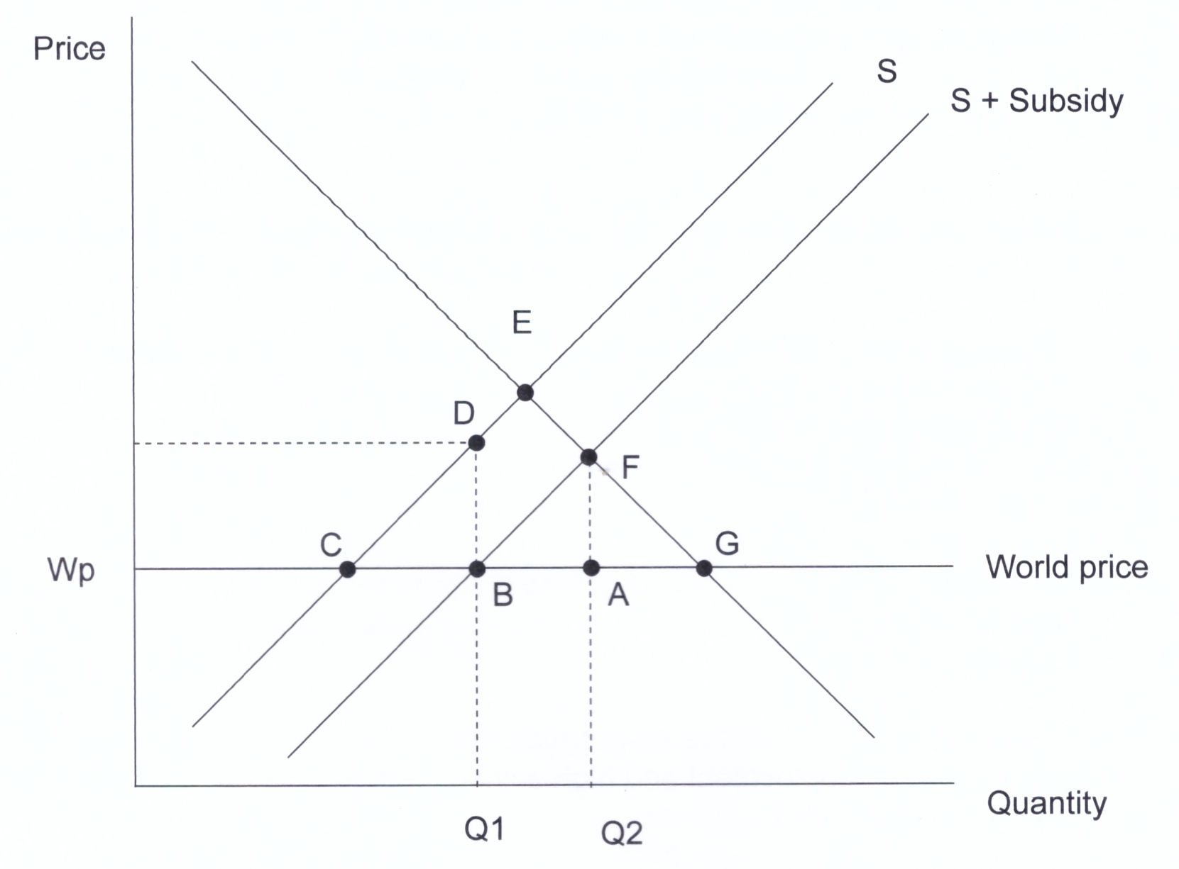

Slide 50
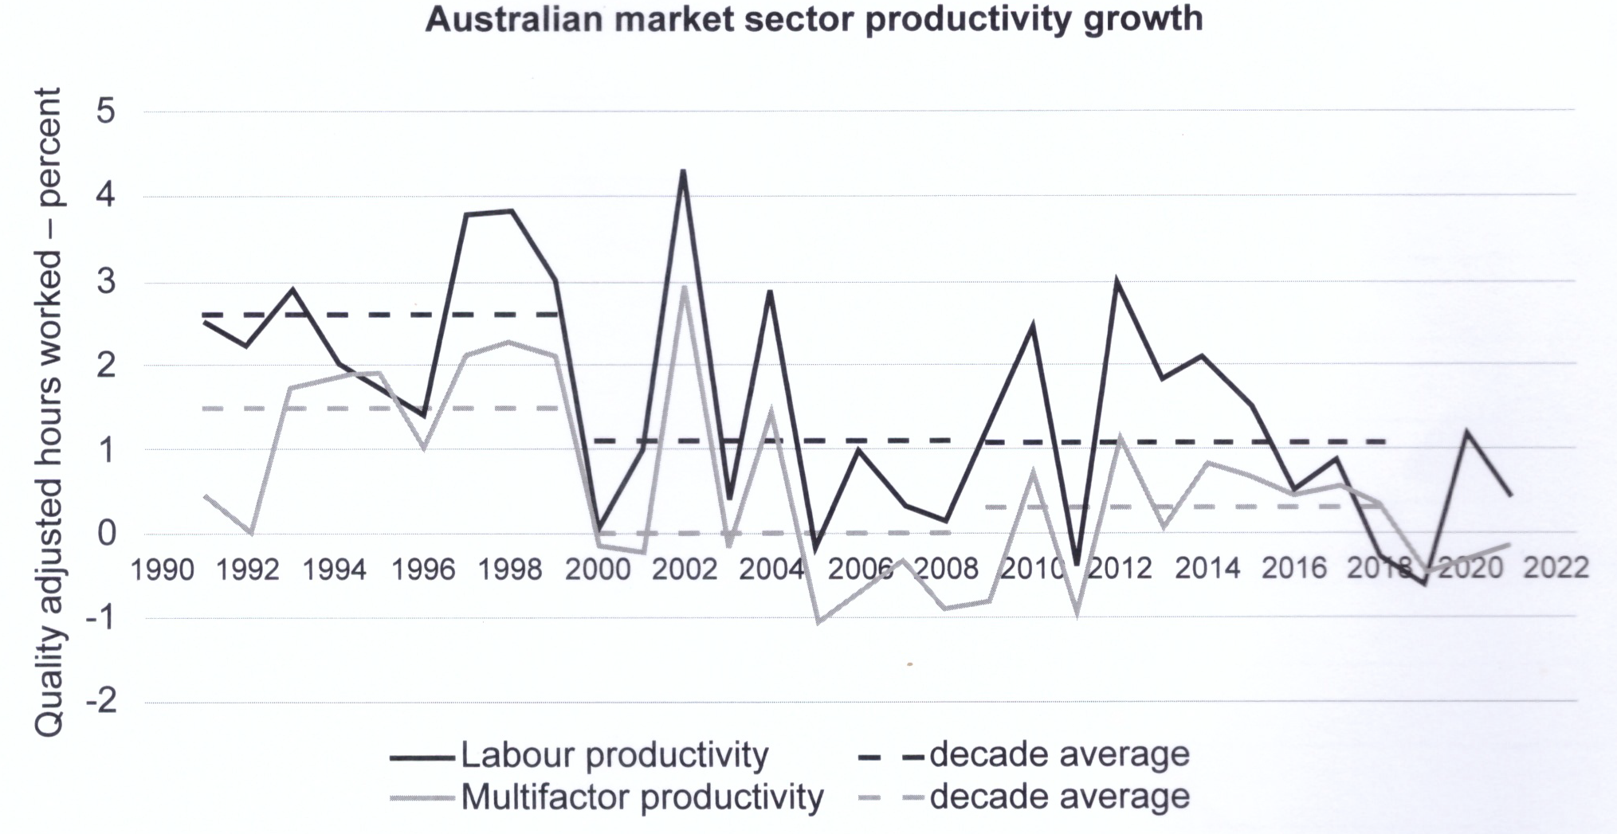

Slide 51
Section 3
Unit 3 Question 28
Assume the AUD depreciates from $US0.75 to $US0.70
An imported car costing $US45,000 will increase in price from $A60,000 to $A64,286
If iron ore is selling for $US100 per tonne, then the price in AUD will increase from $A133 to $A143
So a depreciation will raise both import and export prices & have minimal impact on the terms of trade

Slide 52
Section 3
5 marks
Unit 3 Question 29
(a) Describe the concept of ‘foreign liabilities’ and explain the influence of foreign liabilities on Australia’s current account. (8 marks) Mean = 46%
3 marks
Define foreign liabilities – 1 mark
Define foreign debt – 2 marks
Define foreign equity – 2 marks
Explain the influence on the current account – 3 marks

Slide 53
Section 3
Unit 3 Question 29
(b) Discuss three ways in which foreign investment has affected the Australian economy in recent years. (12 marks) Mean = 40%
What is a ‘way’?
This is not simply listing effects of foreign investment
Need to think of THREE categories (4 marks each)
The macroeconomy
The savings-investment gap
The mining sector
The balance of payments
Either foreign investment in or foreign investment out

Slide 54
Section 3
Unit 4 Question 30
(a) Outline the economic policy objectives of the Australian Government and describe the extent to which these may conflict with or complement each other. (10 marks) Mean = 43%
Outline does not mean ‘list’!
Outline 5 separate objectives – 5 marks
For each objective describe whether it complements of conflicts with another objective – 5 marks

Slide 55
Section 3
Unit 4 Question 30
(b) Outline the two methods used to measure productivity and, using an AD/AS model, illustrate and explain the impact of productivity growth on the achievement of any three economic objectives. (10 marks) Mean = 48%
Define labour productivity & multifactor productivity – 2 marks
Explain impact on 3 economic objectives – 6 marks
AD/AS model showing increase in AS – 2 marks

Slide 56
Section 3
Unit 4 Question 31
(a) Explain the meaning of a ‘budget deficit’ and describe three methods the Australian Government can use to finance a budget deficit. (8 marks) Mean = 62%
Meaning of budget deficit – 2 marks
Describe 3 methods of financing – 6 marks

Slide 57
Section 3
Unit 4 Question 31
(b) Using the aggregate expenditure (AE) model, explain the short and long-term implications of the contemporary fiscal policy measures adopted by the Australian Government. (12 marks) Mean = 35%
Is contemporary fiscal policy expansionary or contractionary?

Slide 58
Section 3
Unit 4 Question 31
Contemporary fiscal policy
YEAR | REVENUE $m | SPENDING $m | BALANCE $m
2018-19 | 485,286 | 478,098 | -690
2019-20 | 469,398 | 549,634 | -85,272
2020-21 | 519,913 | 654,084 | -134,171
2021-22 | 584,358 | 616,320 | -31,962
2022-23 (e) | 607,229 | 644,080 | -36,851
2023-24 (e) | 621,441 | 665,489 | -44,048
Highly expansionary
Less expansionary

Slide 59
Section 3
If the budget deficits are falling – does this mean that fiscal policy is contractionary?
PL
No!
Year | Budget Deficit | Multiplier | Effect on AD
1 | $100bn | 2.5 | +$250bn
2 | $60bn | 2.5 | +$150bn
3 | $40bn | 2.5 | +$100bn
$250b
$150b
$100b
AD
AD1
AD2
AD3
Real GDP

Slide 60
Section 3
Unit 4 Question 31
(b) Using the aggregate expenditure (AE) model, explain the short and long-term implications of the contemporary fiscal policy measures adopted by the Australian Government. (12 marks) Mean = 35%
Short term implications – 6 marks
Long term implications – 4 marks
AE model showing upward shift of the AE line – 2 marks

Slide 61
Topical
Australia records a current account deficit
Australia recorded a $2.3 billion current account deficit in the September quarter 2022, following 13 consecutive quarters of a current account surplus.
The trade balance decreased by $11 billion but remained in a surplus of $31b, while the net primary income deficit widened by $6.4 billion to $33 billion in the September quarter 2022.

Slide 62
Topical
New trade deal with India enters into force
The Australia-India Economic Cooperation and Trade Agreement (ECTA) was signed in December 2022.
Tariffs on 85 per cent of Australia's exports to India will be eliminated – this will save Australian exporters around $2 billion a year
Australian consumers and business will save on imports of finished goods, and inputs to our manufacturing sector.
Education exports will be a big winner.

Slide 63
Questions

