Slide 1



etawa
Sundowner
2023
Steven Kemp

Slide 2
School Visits
Good news!
Curtin University are continuing to sponsor my school visits in 2023
If you would like me to visit your class then call, text or email
Email: stevenkemp@me.com
Mobile: 0407986901

Slide 3


Exam Papers
Unit 3 – from etawa
If you want a Unit 4 exam paper/marking guide call or text me (0407986901)
Need around 10 schools to make it viable

Slide 4
Unit 1 Teaching Slides
  Now available - $90
  What is economics
  Demand & supply
  Elasticity
  Market efficiency
  Market failure

Slide 5
2022 Exam Paper
Section Means
2022 2021 2020
Section 1 73% 68% 70%
Section 2 54% 54% 58%
Section 3 45% 54% 53%
Total 55% 57% 59%
Range: 0 - 97
The reliability of the exam (0.88) was higher than 2020

Slide 6
Section One: Multiple Choice
Range: 0-24; Mean 73% (last year 68%)
Difficult questions ( < 50%): 2
Easy questions: (> 80%) 11 – last year 6
Reliability: 0.71 (last year 0.70)

Slide 7

Section 1
High correlation
59%
6. A financial account surplus would result in
a decrease in Australia's net foreign liabilities.
an increase in Australia's net foreign liabilities.
an increase in Australia's holding of foreign assets.
a reduction in inward foreign investment into Australia.
26%

Slide 8

Section 1
Low mean 47%
Low correlation
The top four currencies by weight in Australia's trade weighted index (TWI) are
Chinese yuan, Japanese yen, United States dollar and Singapore dollar.
United States dollar, Chinese yuan, Japanese yen and United Kingdom pound sterling.
Chinese yuan, United States dollar, Japanese yen and European euro.
United States dollar, Japanese yen, Chinese yuan and South Korean won.
20%
24%

Slide 9
The TWI
The Australian dollar trade-weighted index (TWI) is the price of the Australian dollar in terms of a ‘basket’ of foreign currencies based on their share of trade with Australia.
The basket contains 17 currencies
For 2023, the new weights are:
1) Chinese renminbi 31%
2) Japanese yen 12.5%
3) European euro 9%
4) US dollar 8%

Slide 10

Section 1
Low mean 50%
High correlation
16. In the Keynesian aggregate expenditure model, macroeconomic equilibrium occurs when
the balance of payments sums to zero.
government expenditure equals government revenue.
inventory levels are constant.
aggregate demand exceeds aggregate supply.
26%

Slide 11

Section 1
64%
Low correlation
Which of the following outlines a difference between labour productivity and multifactor productivity?
Multifactor productivity is easier to measure than labour productivity.
New capital equipment will only increase multifactor productivity.
Labour productivity is more closely related to workers' wages than multifactor productivity.
Only multifactor productivity improves with technology.

Slide 12

Section 2
The mean was 54%
Range: 0 - 36
Excellent correlation with exam total (0.91)
Q25 – Trade protection (mean = 60%)
Q26 – AUD exchange rate (mean = 50%)
Q27 – Economic indicators (mean = 51%)
Too low
Note – models were required in each of the 3 questions!

Slide 13
Section 2
Question 25
(c) Using an appropriate model, illustrate and explain the effects of a subsidy on domestic production, imports and market efficiency. (6 marks)
Mean = 52%
4 marks – explain the effects on production, imports & market efficiency
2 marks – correctly labelled model showing world price, shift of S curve, domestic production, imports, deadweight loss

Slide 14
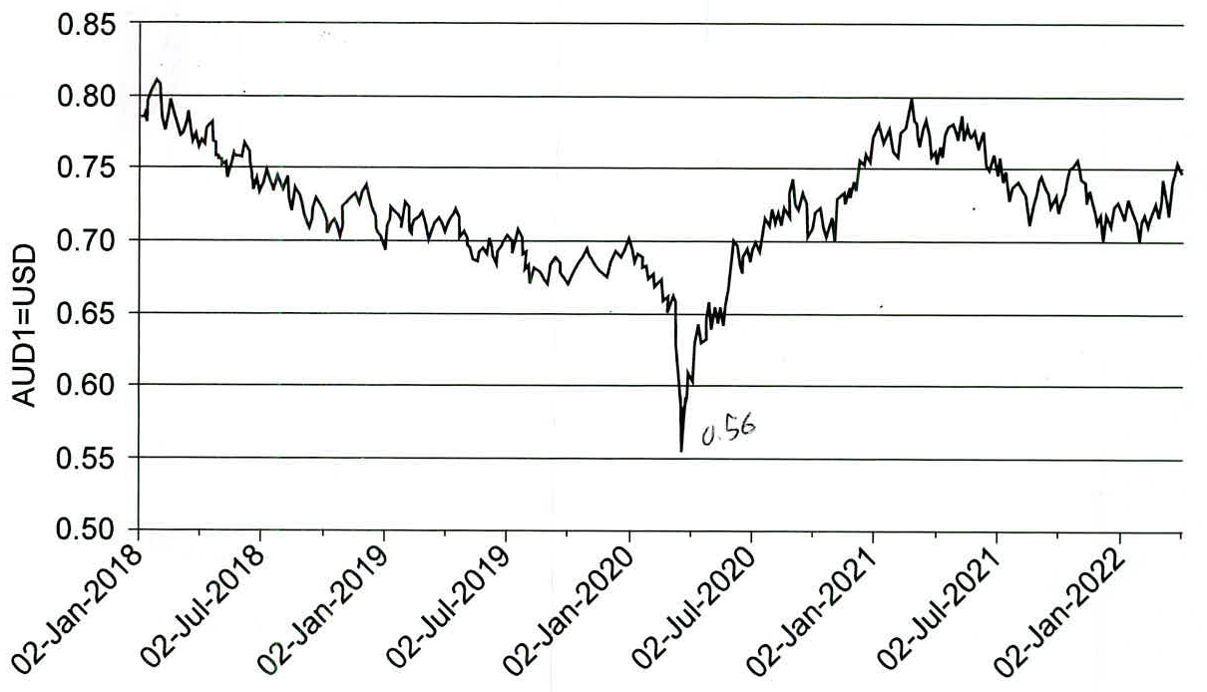
Section 2
Peak $US0.80
Question 26
(a)ii. Calculate the approx. percentage change in the exchange rate from its lowest level in 2020 to its peak in 2021.
AUD/USD Exchange Rate
Lowest $US0.55/56
Mean = 52%

Slide 15
Section 2
Question 26
(a) ii. Calculate the approximate percentage change in the exchange rate from its lowest level in 2020 to its peak in 2021.
Lowest level: between US0.55 and US0.56
Peak: US0.80
% change = (0.80 – 0.56) / 0.56 x 100
= 43% (45% with 0.55)

Slide 16

Section 2
Mean = 40%
Question 26
(c) Using the aggregate demand/aggregate supply (AD/AS) model, explain how a depreciation of the AUD is likely to affect consumers and the business sector of the Australian economy. (6 marks)
2 marks – consumers
2 marks – business sector
2 marks – AD/AS model showing both an increase in AD & a decrease in AS

Slide 17
Section 2
Question 27
(a) Identify the phase of the business cycle the economy experienced between 2020 and 2022.
Expansion or recovery Why?

Slide 18
Section 2
Question 27
(b) Describe two possible causes of the business cycle phase identified in part (a) 4 marks
Mean = 41%
Must refer to the data

Slide 19
Section 2
Mean = 46%
Question 27
Assume that the economic indicators for 2022 applied to the Australian economy.
(c) Using the aggregate expenditure (AE) model, demonstrate the likely stance the RBA would adopt in order to influence economic activity, and explain the impact of this stance. (6 marks)
4 marks – identifies expansionary stance, provides a reason for this stance, explains the transmission mechanism, explains the impact on the economy and include the multiplier!!!
Might as well throw in the kitchen sink as well!
2 marks – AE model showing an upward shift in the AE line

Slide 20
Section 1
20. Assume the Australian economy is experiencing the following economic conditions:
Inflation = 2.0%
Economic growth = 1.5%
Unemployment = 6.5%
On the basis of the data, the RBA would most likely
leave the cash rate unchanged . . .
increase the cash rate . . .
sell govt bonds . . .
reduce the cash rate . . .

Slide 21

Section 3
The mean for this section was 45%. Range: 0 – 39
Low correlation with exam total 0.76
The two Unit 4 questions referred to a model
Q28 – Terms of trade (mean 46%; chosen by 64%)
Q29 – Foreign liabilities (mean 43%; chosen by 34%)
Q30 – Policy objectives/productivity (model)
  (mean 45%; chosen by 46%)
Q31 – Budget deficit/fiscal policy (model)
  (mean 46%; chosen by 52%)
All questions below 50%

Slide 22
Section 3
4 x 2 marks
2 marks
Unit 3 Question 28
(a) Explain the meaning of the ‘terms of trade’ and describe four factors that may influence Australia’s terms of trade. (10 marks) Mean = 45%
Describe the meaning – 2 marks
FOUR factors – 8 marks
  Factors that can affect the export price index e.g. commodity prices; China; drought
  Factors that can affect the import price index e.g. oil prices; China; transport costs

Slide 23
Section 3
Unit 3 Question 28
Can a change in the AUD exchange rate affect Australia’s terms of trade?
Assume the AUD depreciates
  This will increase the price of Australia’s imports, increase the MPI & decrease the terms of trade
  But most of Aust’s exports are priced in $US, so a depreciation will result in higher prices to Australian exporters, increasing both the XPI & the terms of trade
  Net result – minimal change

Slide 24
Section 3
Unit 3 Question 28
Assume the AUD depreciates from $US0.75 to $US0.70
  An imported car costing $US45,000 will increase in price from $A60,000 to $A64,286
  If iron ore is selling for $US100 per tonne, then the price in AUD will increase from $A133 to $A143
  So a depreciation will raise both import and export prices & have minimal impact on the terms of trade

Slide 25
Section 3
2 marks
Unit 3 Question 28
(b) Describe the contemporary trend in Australia’s terms of trade and explain four impacts of this trend on the level of economic activity. (10 marks) Mean = 47%
4 x 2 marks
Describe the trend – 2 marks
FOUR impacts on economic activity – 8 marks

Slide 26
Section 3
Unit 3 Question 28
(b) Describe the trend in Australia’s terms of trade
The trend is increasing (favourable) – from 93 in June 2019 to 118 in June 2022

Slide 27
Section 3
Unit 3 Question 28
(b) Describe the contemporary trend in Australia’s terms of trade and explain four impacts of this trend on the level of economic activity. (10 marks) Mean = 47%
FOUR impacts on economic activity – 8 marks
Increase in aggregate demand (AD)
Increase in real GDP and std of living
Increase in employment
Increase in rate of inflation
Increase in investment into the mining sector

Slide 28
Section 3
5 marks
Unit 3 Question 29
(a) Describe the concept of ‘foreign liabilities’ and explain the influence of foreign liabilities on Australia’s current account. (8 marks) Mean = 46%
3 marks
Define foreign liabilities – 1 mark
Define foreign debt – 2 marks
Define foreign equity – 2 marks
Explain the influence on the current account – 3 marks

Slide 29
Section 3
Unit 3 Question 29
(b) Discuss three ways in which foreign investment has affected the Australian economy in recent years. (12 marks) Mean = 40%
What is a ‘way’?
This is not simply listing effects of foreign investment
Need to think of THREE categories (4 marks each)
The macroeconomy
The savings-investment gap
The mining sector
The balance of payments
Either foreign investment in or foreign investment out

Slide 30
Section 3
Unit 4 Question 30
(a) Outline the economic policy objectives of the Australian Government and describe the extent to which these may conflict with or complement each other. (10 marks) Mean = 43%
Outline does not mean ‘list’!
Outline 5 separate objectives – 5 marks
For each objective describe whether it complements of conflicts with another objective – 5 marks

Slide 31
Section 3
Unit 4 Question 30
(b) Outline the two methods used to measure productivity and, using an AD/AS model, illustrate and explain the impact of productivity growth on the achievement of any three economic objectives. (10 marks) Mean = 48%
Define labour productivity & multifactor productivity – 2 marks
Explain impact on 3 economic objectives – 6 marks
AD/AS model showing increase in AS – 2 marks

Slide 32
Section 3
Unit 4 Question 31
(a) Explain the meaning of a ‘budget deficit’ and describe three methods the Australian Government can use to finance a budget deficit. (8 marks) Mean = 62%
Meaning of budget deficit – 2 marks
Describe 3 methods of financing – 6 marks

Slide 33
Section 3
Unit 4 Question 31
(b) Using the aggregate expenditure (AE) model, explain the short and long-term implications of the contemporary fiscal policy measures adopted by the Australian Government. (12 marks) Mean = 35%
Is contemporary fiscal policy expansionary or contractionary?

Slide 34
Section 3
Unit 4 Question 31
Contemporary fiscal policy
YEAR | REVENUE $m | SPENDING $m | BALANCE $m
2018-19 | 485,286 | 478,098 | -690
2019-20 | 469,398 | 549,634 | -85,272
2020-21 | 519,913 | 654,084 | -134,171
2021-22 | 584,358 | 616,320 | -31,962
2022-23 (e) | 607,229 | 644,080 | -36,851
2023-24 (e) | 621,441 | 665,489 | -44,048
Highly expansionary
Less expansionary

Slide 35
Section 3
If the budget deficits are falling – does this mean that fiscal policy is contractionary?
PL
No!
Year | Budget Deficit | Multiplier | Effect on AD
1 | $100bn | 2.5 | +$250bn
2 | $60bn | 2.5 | +$150bn
3 | $40bn | 2.5 | +$100bn
$250b
$150b
$100b
AD
AD1
AD2
AD3
Real GDP

Slide 36
Section 3
Unit 4 Question 31
(b) Using the aggregate expenditure (AE) model, explain the short and long-term implications of the contemporary fiscal policy measures adopted by the Australian Government. (12 marks) Mean = 35%
Short term implications – 6 marks
Long term implications – 4 marks
AE model showing upward shift of the AE line – 2 marks

Slide 37
Topical
Australia records a current account deficit
Australia recorded a $2.3 billion current account deficit in the September quarter 2022, following 13 consecutive quarters of a current account surplus.
The trade balance decreased by $11 billion but remained in a surplus of $31b, while the net primary income deficit widened by $6.4 billion to $33 billion in the September quarter 2022.

Slide 38
Topical
New trade deal with India enters into force
The Australia-India Economic Cooperation and Trade Agreement (ECTA) was signed in December 2022.
Tariffs on 85 per cent of Australia's exports to India will be eliminated – this will save Australian exporters around $2 billion a year
Australian consumers and business will save on imports of finished goods, and inputs to our manufacturing sector.
Education exports will be a big winner.

Slide 39
Questions

