Slide 1
Role of fiscal policy in Australia during COVID-19 pandemic
Dr. Owen Freestone – Manager, Commonwealth Treasury
Presentation to WA students
15 September 2020
This presentation is based on publically available data from the 2020 July Economic and Fiscal Update unless otherwise stated.

Slide 2
What is fiscal policy?
Fiscal policy involves setting government taxes and expenditure.
The aim of fiscal policy is stable and sustainable economic growth.
There are multiple ways to meet this aim:
  Stabilisation – “macro management”
  Redistribution – “fairness”
  Allocation – “economic efficiency”
Notes:
So, what is fiscal policy?
Fiscal policy is the means by which a government adjusts its spending levels and tax rates to monitor and influence a nation's economy. It is the sister strategy to monetary policy through which a central bank influences a nation's money supply.
The objective of fiscal policy is to maintain the condition of full employment, economic stability and to stabilize the rate of growth.
There are many ways to meet this aim, and I’ll cover these in further detail in subsequent slides.
1. Fiscal measures, to a larger extent, promote economic stability in the face of short-run international cyclical fluctuations, and in the case of a serious economic downturn, can be deployed through fiscal stimulus to bring the economy back on track.
2. Redistribution alters the distribution of income and wealth between entities in the economy in order to promote fairness in line with society’s preferences. For example, Australia’s progressive income tax system taxes higher income earners at a higher rate than lower income earners.
3. Fiscal measures like taxation and public expenditure programmes, can greatly affect the allocation of resources in various occupations and sectors.
When the government changes its spending or revenue collection it influences their behaviour by changing their financial incentives. For example a subsidy or a tax cut can encourage people to spend more in a particular area.

Slide 3
Stabilisation function
Smooth short-term economic fluctuations
Intersects with monetary policy, and more recently macro-prudential policy
Australian counter-cyclical fiscal policy takes a couple of forms:
  Automatic stabilisers (dominant approach)
    Rule based, non-discretionary, passive changes to fiscal outcomes: welfare payments (unemployment), progressive taxes
  Discretionary
    Active, (typically) temporary changes: tax holidays, tax cuts, transfers (cash payments) or other spending

Slide 4
Stabilising the business cycle

Slide 5
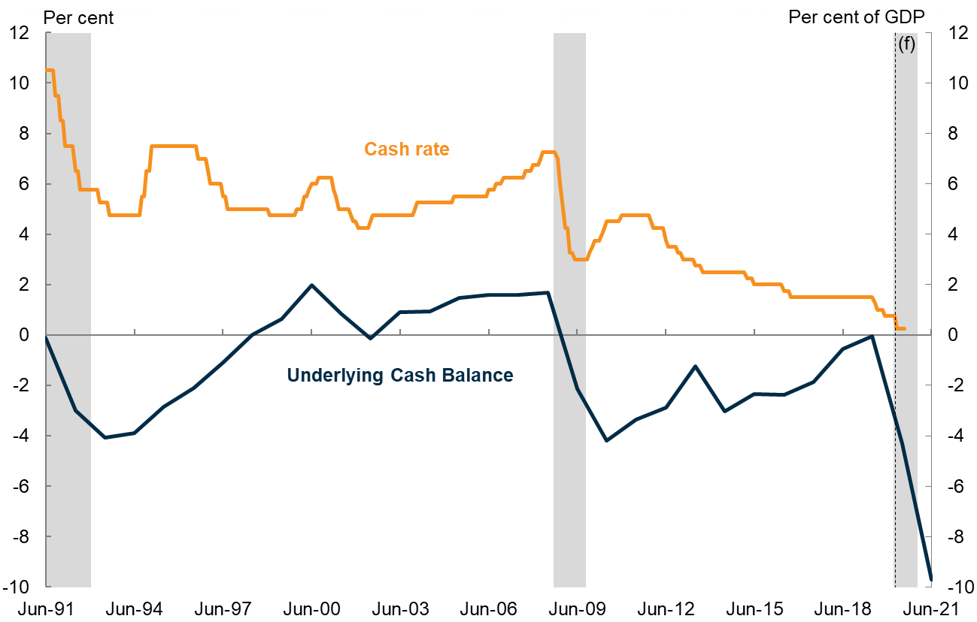
Role of monetary and fiscal policy
Note: Underlying cash balance is shown as a share of GDP. Grey shading represents the 1990s recession, the Global Financial Crisis and COVID-19. This shading covers dates from Jun-91 to Dec-92 (when unemployment peaked), Sept-08 to Sept-09, and Mar-20 to Dec-20. Forecasts from July Economic and Fiscal Update.
Source: Treasury.

Slide 6
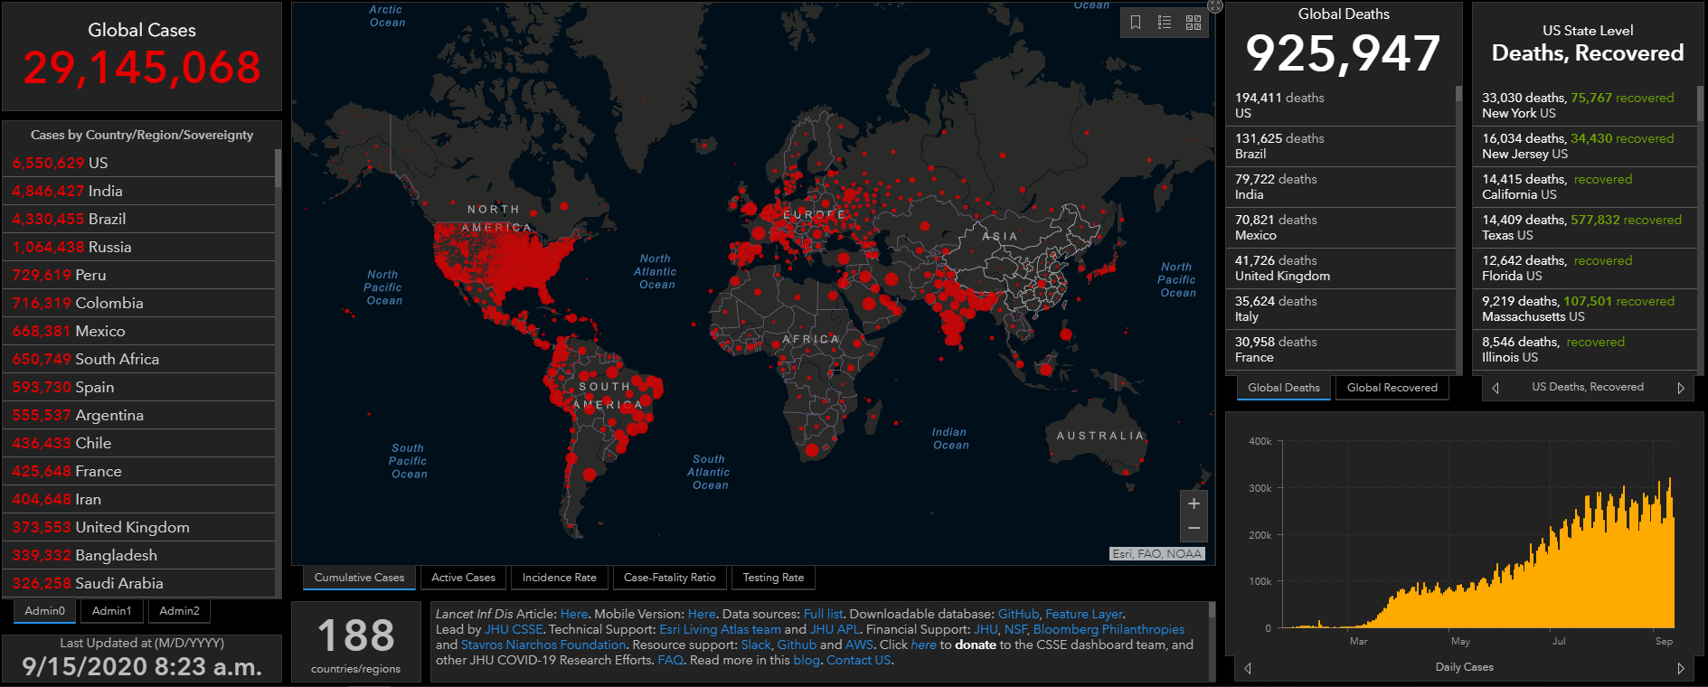
Global active cases
(as at 15 September 2020)
Source: John Hopkins Coronavirus Resource Center, Treasury.

Slide 7
Global daily confirmed cases and deaths
(as at 15 September)
Source: John Hopkins Coronavirus Resource Center, Treasury.

Slide 8
Fiscal measures by category over time
(impact on underlying cash balance)
Source: July Economic and Fiscal Update.
Note: The coronavirus measures in this chart only include economic measures. Health measure are not included.

Slide 9

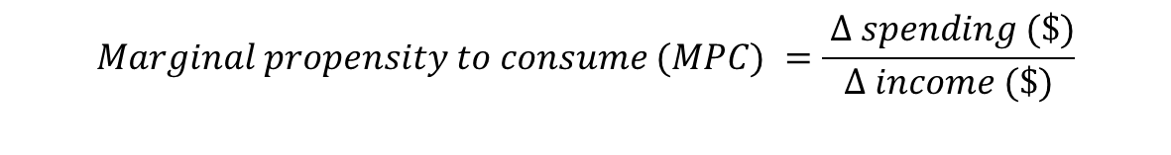
Direct fiscal multiplier
$$GDP multiplier=\frac{Δ GDP (\$)}{budget cost (\$)}$$
$$GDP multiplier=MPC∗(1−import leakage)$$
$$Marginal propensity to consume (MPC) =\frac{ Δ spending (\$)}{Δ income (\$)}$$

Slide 10
Real GDP before and after economic support
Source: ABS cat. no. 5206.0 and Treasury.
Note: Forecasts from July Economic and Fiscal Update.

Slide 11
Unemployment rate before and after economic support
Source: ABS cat. no. 6202.0 and Treasury.
Note: Forecasts from July Economic and Fiscal Update.

Slide 12
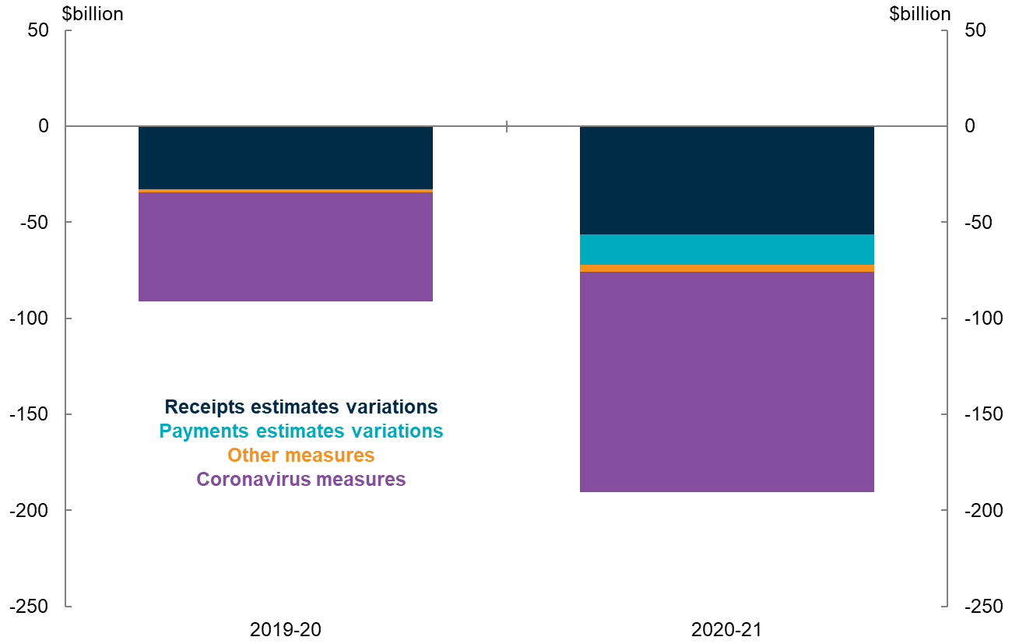
Discretionary and automatic fiscal response
(new measures versus automatic changes in receipts and payments)
Source: July Economic and Fiscal Update.
Note: The coronavirus measures in this chart include health measures. Data from July Economic and Fiscal Update.

Slide 13
International real GDP growth comparisons
(Six months to June quarter 2020)
Source: Treasury and national statistical agencies.
Notes:
Stack bars charts

Slide 14
Contributions to real GDP growth
(June quarter 2020)
Source: ABS cat. no. 5206.0 and Treasury.
Note: The sum of individual components may not add to the aggregate due to rounding and the omission of the statistical discrepancy.

Slide 15
Consumption by category
(June quarter 2020)
Source: ABS cat. no. 5206.0 and Treasury.

Slide 16
International gross debt comparison
Source: IMF World Economic Outlook Update June 2020 and Treasury.
Note: Data from IMF. General government gross debt includes central, state, territory and local governments.

Slide 17
Role of fiscal policy in Australia during COVID-19 pandemic
Dr. Owen Freestone – Manager, Commonwealth Treasury
Presentation to WA students
15 September 2020
This presentation is based on publically available data from the 2020 July Economic and Fiscal Update unless otherwise stated.

